Slide 1
Accessibility Team 10
Annie, Cyrus, and Steven

Slide 2
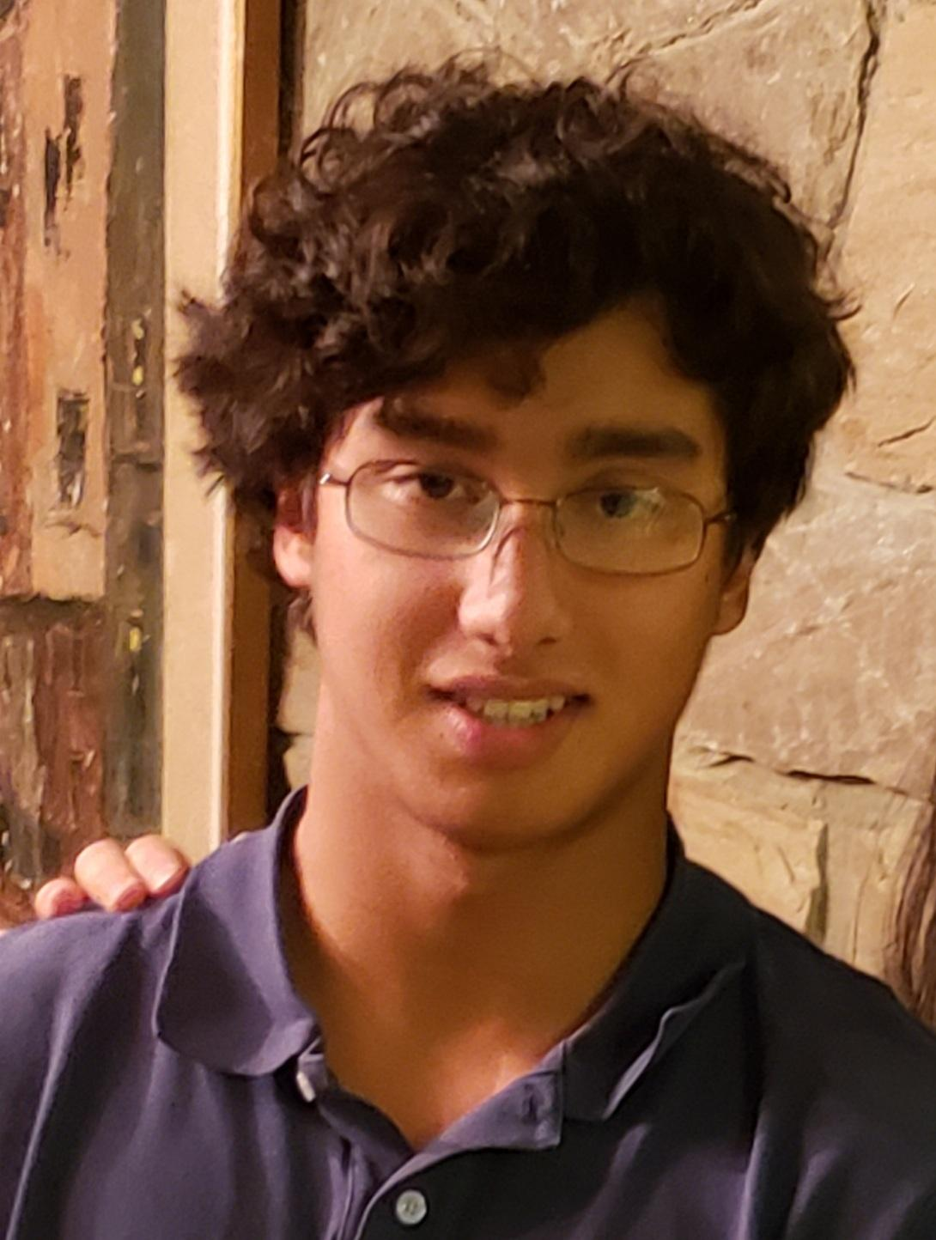
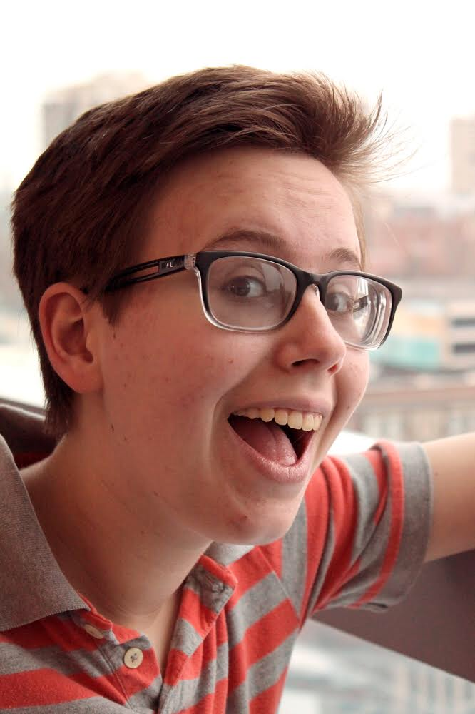
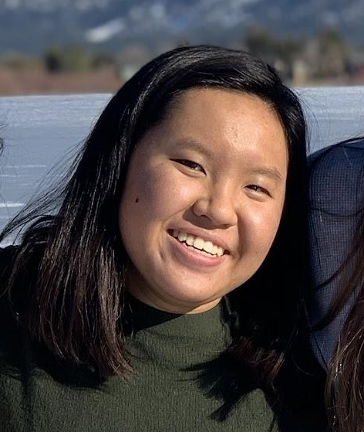
Our Team
Annie N.
Steven G. O.
Cyrus D.
2024, Symbolic Systems
2023, Electrical Engineering
202?, Computer Science

Slide 3
Problem Domain: Old Folks + Community
70 or older & self-identified
Notes:
Narrowed down
Find, Interact, Engage

Slide 4
Initial POV:
We met Eva, a 98 year old who is in great physical health, mentally sharp, and lives in a care home.
We surprised to notice that she feels like she doesn’t know the other residents.
We wonder if this means other residents also struggle to know each other.
It would be game-changing to provide opportunities for everyone to find community.
Notes:
Interviewed last week
Surprised - even after living there for 2 yrs
Wonder
Therefore,

Slide 5
Additional Interviews
Gil & Marcy | Steven’s grandparents <3
Lulu | [redacted for privacy]
Notes:
Care home - Gil, Marcy
Lulu, not care home, senior living community

Slide 6
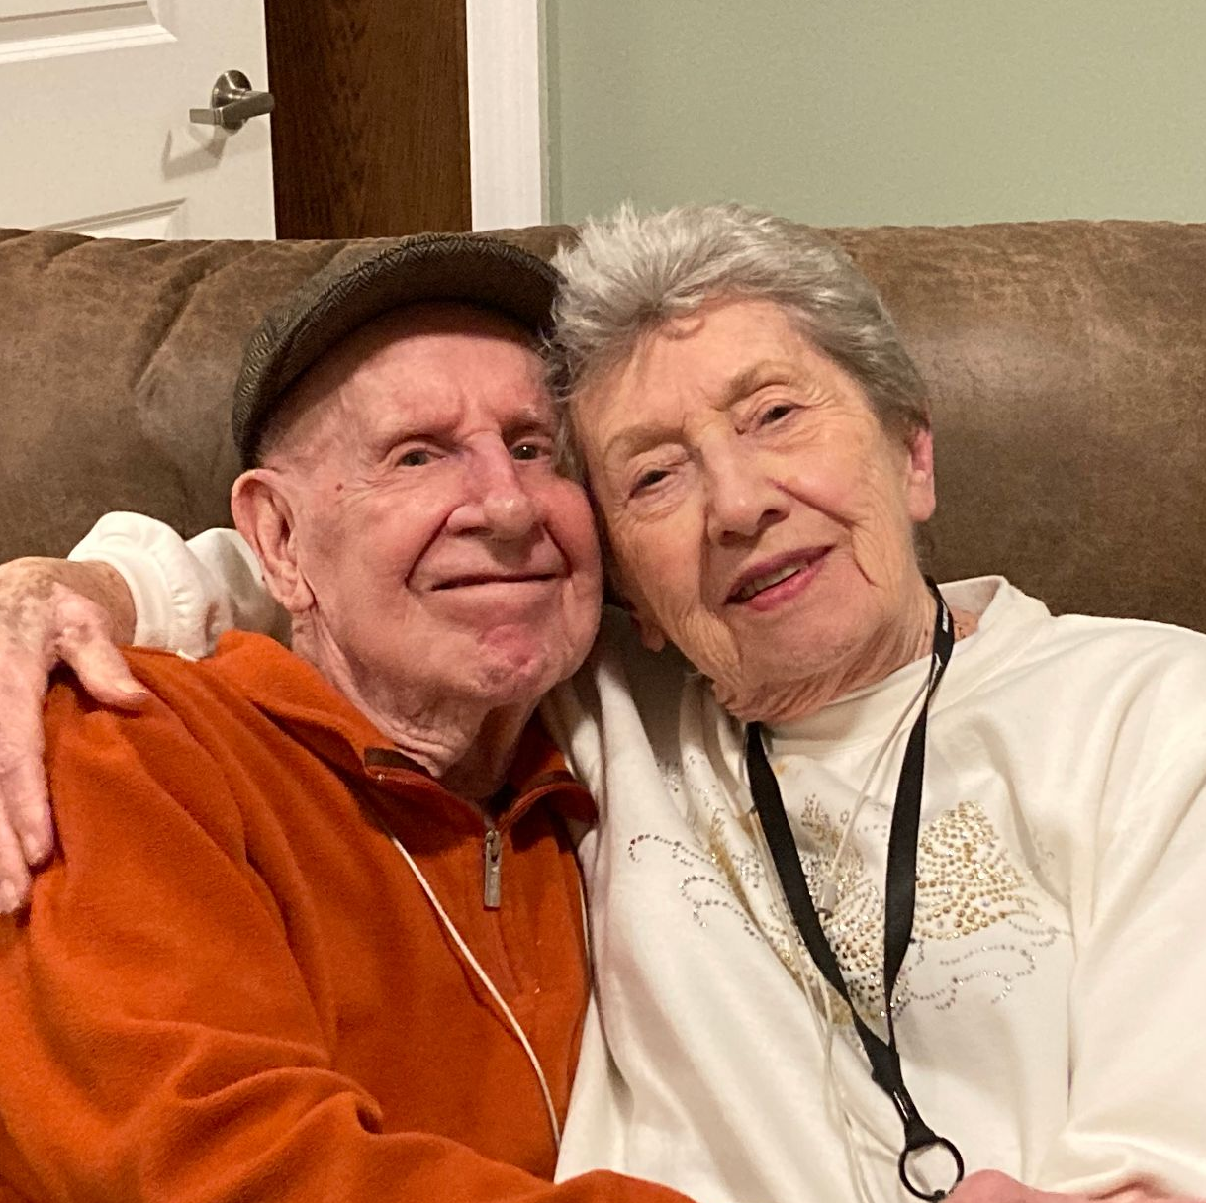
Gil & Marcy
“It’s not hard to get to know people, just get together and spend time.”
“[Marcy] takes good care of me, otherwise I don’t get along.”
Notes:
Grandpa, as suggested, has dementia, insight into the lives of people with mental impaired abilities
Contrast with Eva
Enjoy games, such as Bingo, card games, making crafts
Team, strong couple

Slide 7
Lulu
“When you’re working 9 - 5 you have your community - coworkers, commuters on the train. Now it’s up to you.”
“Every community ends after a while”
Notes:
Accountant, dedicated to company and working mother
Retire - no spontaneous interactions, retired proactive
Children grow up, moved a lot, many clubs, things in life end
Further need for finding new communities

Slide 8
Key Takeaways
Desire to be involved with the people around them
Help people in their community
Want to have fun
Notes:
Gil - play Bingo, referred to parts of life by job, RR, old folks home - wants purpose
Lulu - socialize, helps senior friends with technology
Come back to later in solutions

Slide 9
Revised POV 1
We met Eva, a 98 year old who is in great physical health, mentally sharp, and lives in a care home.
We were surprised to notice Bingo is the most popular activity by far, which Eva hates.
We wonder if this means some older people want/need simple, low-intensity activities.
It would be game-changing to connect folks of different ability levels.
Notes:
Tension - organizes many events for the care home but no one comes
Many residents in wheelchair or not as mentally strong.
Mind stimulating
Emotions - frustration, jealousy, loneliness
Create a game that is a hit like bingo?
Encourage old people to try a new activity?
HMW involve high-ability folks in the planning/helping for low-ability folks?
Build on what works for bingo? Bingo 2.0?
Make Eva not hate bingo?
Accommodate the needs of old folks who need more assistance?
HMW make simple activities more fun for high-ability folks?
HMW target activities at high-ability and provide assistance to help low-ability people get to the necessary level?
HMW create groups of mixed ability level?
HMW empower low-ability folks to do things “above” their ability?
HMW give low-ability folks confidence to push their boundaries?

Slide 10
Revised POV 2
We met Susan, a 78 year old who volunteers extensively in care homes and in her community.
We were surprised to notice her emotional connection to the people she helps.
We wonder if this means caregivers feel an emotional connection to those they help (and vice versa?)
It would be game-changing to amplify the old person / caregiver connection.
Notes:
She teared up describe
While volunteer, happened bedside of man dying
No connections, Christmas
Provide more opportunities for caregivers to interact with their subjects in fun activities
HMW have caregivers and old folks learn more about each other?
Make opportunities for old ppl / caregivers to meet
HMW make caregiving feel less servant-y and more friendship?
Caregiver/caree team building exercise
Create a network of caregivers to share ideas
Create a caregiver society in a local area
Make interactions more fun?
Allow a more informal/friendly relationship?
HMW use choice to increase emotional connection?

Slide 11
Revised POV 3
We met Susan, a 78 year old who volunteers extensively in care homes and in her community.
We were surprised to notice her energy to be involved in the community at her age.
We wonder if this means more people want to actively have a positive impact on older people’s lives but don’t know how and/or don’t have time.
It would be game-changing to provide clearer ways to actively have a positive impact on older people’s lives and help people find time / incentivize people.
Notes:
Care home, church, cancer society, more
Goes above beyond, others can contribute to help
HMW involve old folks in the Do Good-ing?
HMW free up people’s time?
HMW clarify ways people can Do Good?
Daily email of things to do good today
Create local community volunteer/engagement opportunity to support old folks?
Make a game out of it? (points for do good)
Make the space for Doing Good?
Make opportunities more well known?
HMW demonstrate to people that Doing Good is an option?
Build into people’s times?

Slide 12
POV → HMW
We met Susan, a 78 year old who volunteers extensively in care homes and in her community.
We were surprised to notice her emotional connection to the people she helps.
We wonder if this means caregivers feel an emotional connection to those they help (and vice versa?)
It would be game-changing to amplify the old person / caregiver connection.
HMW make a care home feel like a co-op / dorm?
Notes:
College - more community atmosphere
Amplify connections

Slide 13
POV → HMW
We met Susan, a 78 year old who volunteers extensively in care homes and in her community.
We were surprised to notice her energy to be involved in the community at her age.
We wonder if this means more people want to actively have a positive impact on older people’s lives but don’t know how and/or don’t have time.
It would be game-changing to provide clearer ways to to actively have a positive impact on older people’s lives and help people find time / incentivize people.
HMW make the process between thinking “I want to help old people” and actually showing up quick and easy?
Notes:
Make it easier to volunteer and serve old folks

Slide 14
POV → HMW
We met Susan, a 78 year old who volunteers extensively in care homes and in her community.
We were surprised to notice her energy to be involved in the community at her age.
We wonder if this means more people want to actively have a positive impact on older people’s lives but don’t know how and/or don’t have time.
It would be game-changing to provide clearer ways to to actively have a positive impact on older people’s lives and help people find time / incentivize people.
HMW make older people connect with young people they don’t know / aren’t related to?
Notes:
Making new relationships

Slide 15
SOLUTIONS

Slide 16
Solution 1
HMW make a care home feel like a co-op / dorm?
People pitch in to different areas; everybody does something
Notes:
Sense of being involved, service, overall feel better

Slide 17
Solution 2
HMW make the process between thinking “I want to help old people” and actually showing up quick and easy?
An easily accessible one-page document that clearly outlines the necessary steps
Notes:
Streamline the process
Reduce any obstacle to only desire to help

Slide 18
Solution 3
HMW make the process between thinking “I want to help old people” and actually showing up quick and easy?
Old folks post things they need help with (e.g. cleaning yard)
Notes:
Request sent out to all social media
Someone will come help

Slide 19
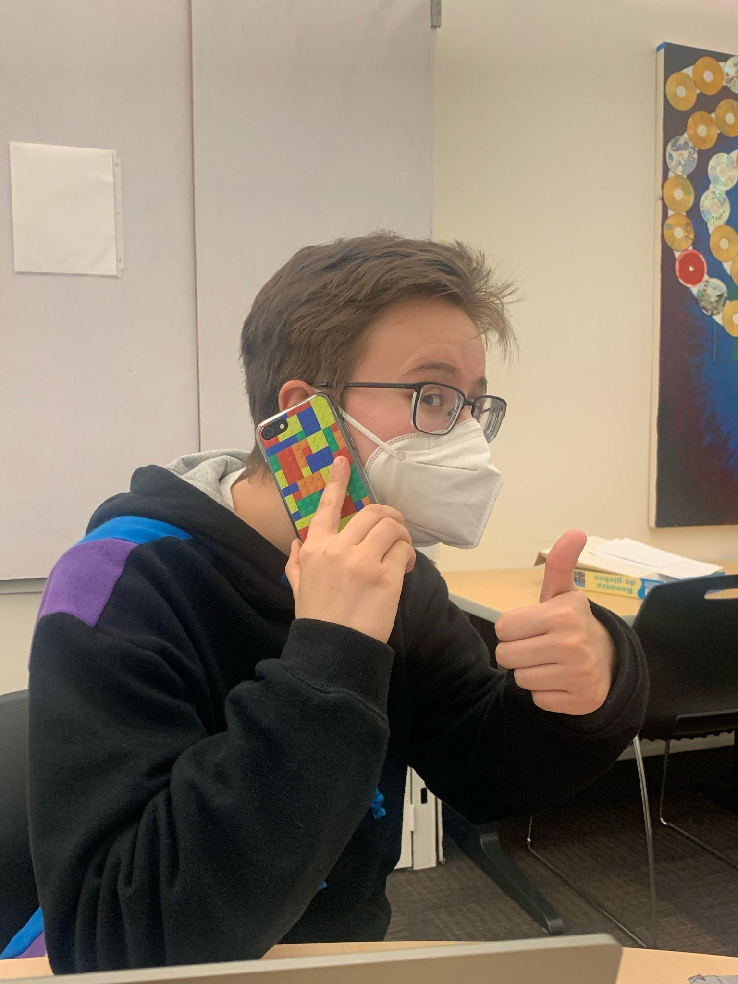
Prototype 1: Mock Sales Call
Assumption: People would want to do (or wouldn’t object to doing) tasks.
Phone call with daughter of “potential resident” introducing our system
Heavily dependent on the person
Asked several questions about the implementation that we hadn’t considered
Valid: some people would like it and feel good about it
Most people could find something to contribute
Notes:
Found out heavily dependent - what they want / can do
Think validated - some seniors would be open
Find chore, share talents to serve a common cause

Slide 20
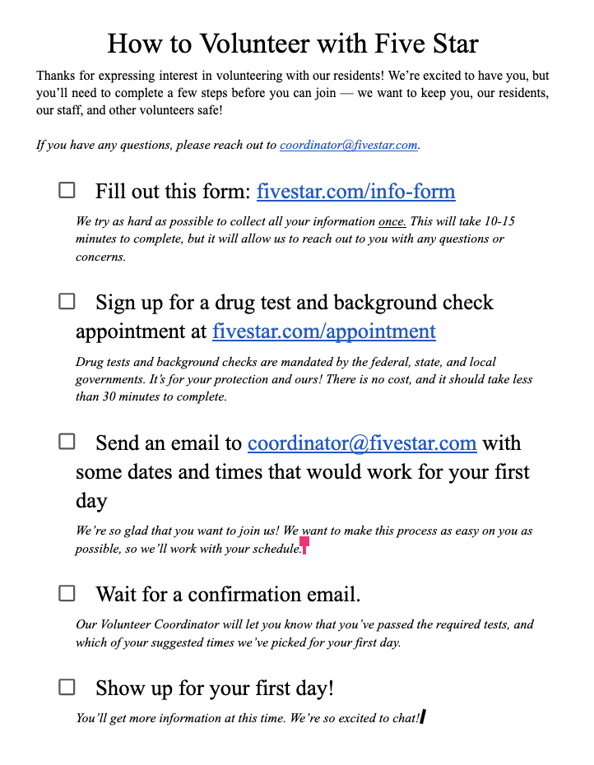
Prototype 2: Process Checklist
Assumption: People would find a list/document format helpful.
Zoom call with “future volunteer”
List of tasks for potential, young volunteer to work with older people
Worked: good idea of paperwork, informative as to why these steps are needed, checkboxes
Surprise: wondered about proper email format
Valid, but with the consideration of readability
Notes:
Made simple list of here’s how to volunteer here
Worked - simple, reasons for each step
Surprised by interviewee asked format email,
Provide inside form or template
Consider all abilities, make accessible to all

Slide 21
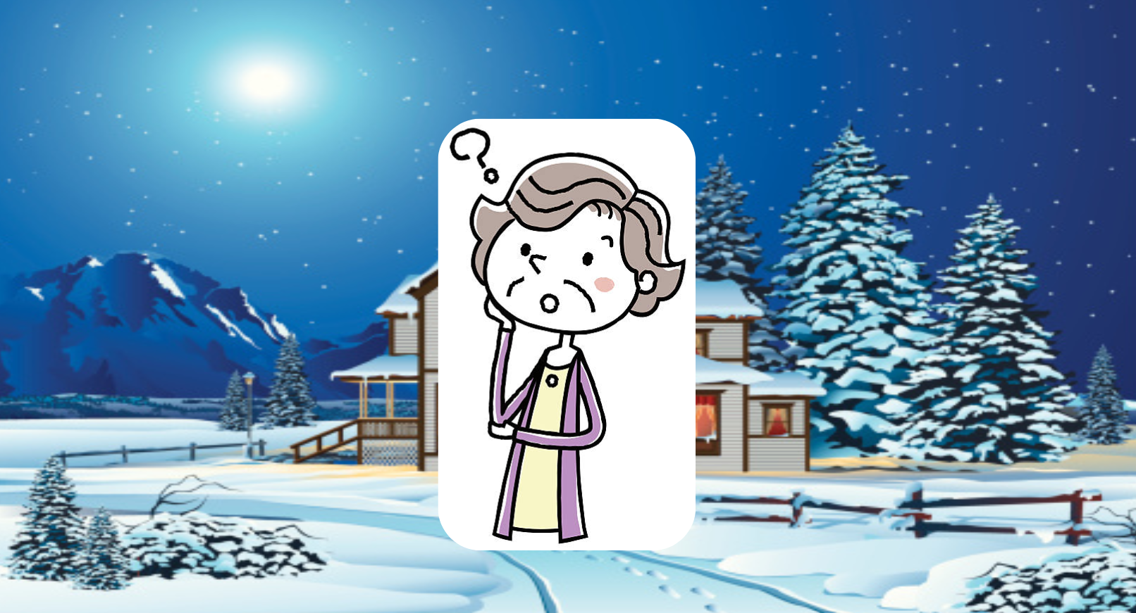
Prototype 3: Quiz
Assumption: People are willing to get help from people they don’t know.
Zoom call with an elderly person who lives alone
Quiz of hypothetical situations
Easy to grasp
Seniors are set in their ways
Okay with cooking but not yard work
Not valid
Notes:
Given options, at what point
Not validate
Choosing family, friends, neighbors, professionals
Someone with high rating and reviews
Surprise

Slide 22
Summary
KEY LEARNING
KEY LEARNING
NEXT STEP
NEXT STEP
Users want prompts and steps to follow; nothing open-ended.
The “Uber model” won’t work for old people.
Pick one?
Combine?
How could this become an app?
(only because of the class)

Slide 23
And thus…
RESIDENTS:
everyone does something
VOLUNTEERS:
simple, accessible checklist
ONWARDS!!!!!
Notes:
Ideas left with

